Slide 1
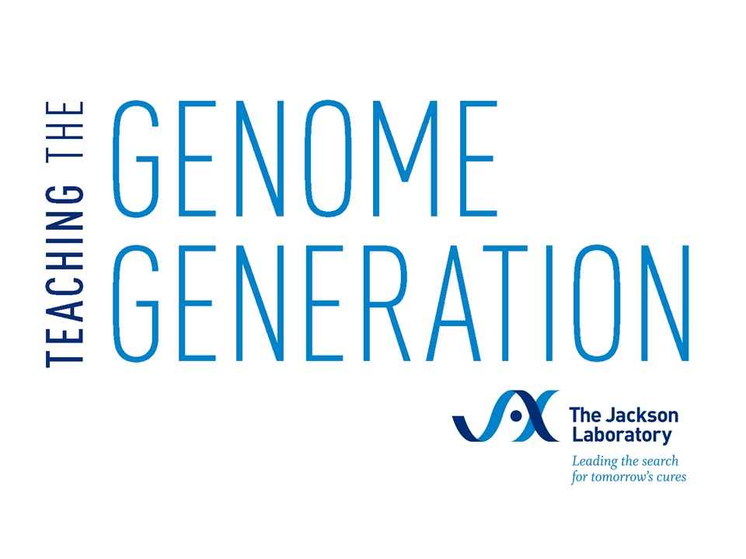
Ancestry Testing
Activity 1:
Introduction to Ancestry Testing
Ancestry Testing | Activity 1: Intro to Ancestry Testing
Notes:
Updated 5/9/25

Slide 2
Sam’s story
What is ancestry testing?
Ancestry Testing | Activity 1: Intro to Ancestry Testing

Slide 3
Sam is a high school student who is about to turn 18 years old. They are at home with their Grandma and cousin Tan. Grandma reveals that the family wants to all contribute to buy Sam a present to celebrate this big milestone birthday. Sam shares that they want a DNA ancestry test for their birthday gift, but gets an unexpected reaction from Grandma.
Read the scene from Sam’s life. Assign one person as Sam, one person as Tan, and one person as Grandma, and read the scene out loud.
Ancestry Testing | Activity 1: Intro to Ancestry Testing

Slide 4
Tan: Happy 18th birthday, Sam! I can’t believe you’re an adult now. You’re so OLD!
Grandma: It feels like just yesterday we were waiting for your arrival in the hospital, Sam. Ah, how time flies!
Tan: Grandma, tell Sam about the gift idea!
Grandma: Right. Sam, this is a big birthday, so the family wants to come together and all chip in to buy you something special. What would you like as a birthday gift?
Sam: Oh, I know exactly what I want! I’m finally old enough, so I want one of those ancestry DNA test kits!
Tan: An-ses-tree? What’s that??
Sam: Haven’t you seen those commercials? You just spit in a tube and send off your DNA and find out where you’re from in the world! It even tells you about your health, like what diseases you’ll get!
Tan: SO cool! I can’t wait to take one when I’m old enough! I want to know all about MY own DNA!
Sam: What’s wrong, Grandma? Aren’t you excited to learn more about our family’s roots?
Grandma: Oh, Sam. We know enough about where our family is from. What’s this test going to tell us that we don’t
already know? And sending your DNA off to a company like that? I just don’t like this idea…
Ancestry Testing | Activity 1: Intro to Ancestry Testing

Slide 5
Prediction
Ancestry Testing | Activity 1: Intro to Ancestry Testing

Slide 6
Sam wants an ancestry test for their 18th birthday. List 2 reasons why someone would want to take an ancestry test.
Grandma has concerns about the ancestry test. List 2 reasons why someone would not want to take an ancestry test.
Sam and Tan talk about being old enough to take an ancestry test. Why might there be age restrictions on DNA ancestry tests?
Ancestry Testing | Activity 1: Intro to Ancestry Testing

Slide 7
Background
Ancestry Testing | Activity 1: Intro to Ancestry Testing

Slide 8
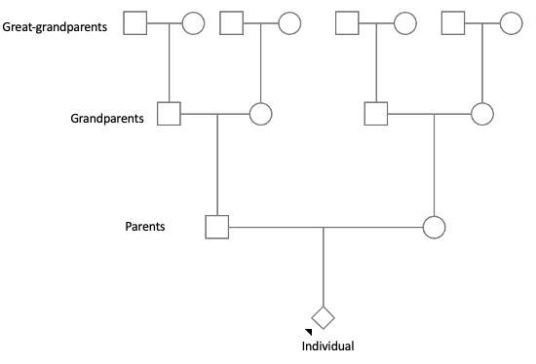
Genetics & Inheritance
Where does our DNA come from?
Each biological ancestor can contribute DNA to an individual
We inherit one half our DNA from each parent
We inherit one quarter of DNA from each grandparent
We inherit one eighth of our DNA from each great-grandparent
Ancestry Testing | Activity 1: Intro to Ancestry Testing
Notes:
When someone talks about their personal genetics, they are often referring to aspects of their own DNA and genome. The human genome is the complete set of DNA in an individual that encodes the instructions for making each of us who we are. Where does this DNA come from? Typically, each person has two biological parents, four grandparents, eight great-grandparents, etc. as shown in the pedigree in Figure 1. Each of these biological ancestors can contribute DNA to the individual. Individuals inherit half of their DNA from each of their two biological parents, one quarter of their DNA from their four biological grandparents, one eighth of their DNA from their eight great-grandparents, and so on. Therefore, individuals are a mix of DNA from their ancestors; biologically related individuals often share some of the same DNA.
In this pedigree, or family tree, an individual is shown at the bottom. Going up the tree reveals some of their biological ancestors: parents, grandparents, and great-grandparents.

Slide 9
Genetic Testing
Clinical genetic tests
Performed by healthcare professionals
Samples collected in a medical setting
Results are shared with the healthcare provider first
Insurance may pay for some or all of the cost
Direct-to-consumer genetic tests
The individual chooses the test
Samples collected by the individual
Results are shared with the individual
The individual pays for the cost
Thought questions:
Have you ever had a test performed at the doctor’s office? Was it a genetic test?
Have you seen advertisements for direct-to-consumer genetic tests? What information would the test reveal?
Ancestry Testing | Activity 1: Intro to Ancestry Testing
Notes:
Genetic testing is a category of laboratory tests that examines an individual’s genes or other biological factors that influence genetic functions and traits. A small sample of cells, typically from blood or saliva, is taken from an individual and DNA, RNA, and/or protein molecules are examined. The goal of genetic testing is to better understand a person’s DNA features, RNA patterns, or protein levels and how they influence a person’s health, traits, or genetic heritage. Many types of genetic tests have been developed for a variety of purposes, including karyotype tests that count the number of chromosomes per cell to look for genetic conditions such as trisomy 21 (Down Syndrome); tumor tests that examine tumor cells to determine drivers of and treatments for cancer; and paternity tests that reveal an individual’s biological relatives.
Most genetic tests are conducted through healthcare professionals like doctors; these types of tests are called clinical genetic tests. Doctors often determine a test is needed due to a specific medical reason, such as a family history of a genetic disorder or symptoms that suggest a genetic condition. Samples like blood or saliva are collected in a medical setting and analyzed in a clinical laboratory. Once the test is complete, the results are sent to the healthcare professional who then shares them with the individual. With clinical genetic tests, health insurance may cover some or all of the cost of the test.
In contrast, direct-to-consumer genetic tests are tests that can be purchased directly by people without a doctor’s order. They are often advertised as a way to learn about your ancestry, genetic traits, or health risks directly from your DNA. Individuals choose what test they want performed, and collect and send their own samples to the testing company. The testing company analyzes the samples, and once the test is complete the results are sent directly to the individual. With direct-to-consumer genetic tests, the individual pays for all of the cost of the test.

Slide 10
Ancestry Testing
DNA ancestry tests are direct-to-consumer genetic tests
Examine specific locations in an individual’s DNA
Find similarities between groups of people
Predict their ancestral origins
Ancestry Testing | Activity 1: Intro to Ancestry Testing
Notes:
DNA ancestry tests, or genealogical DNA tests, are a type of direct-to-consumer genetic test that examines specific locations in an individual’s DNA to find similarities between groups of people and predict their ancestral origins. Since DNA is passed from biological parents to their offspring, it is possible to trace genetic ancestors by examining a person’s DNA. This process relies on comparing an individual’s DNA to reference databases containing genetic information from populations of people worldwide. Each company uses a different approach to for the ancestry test, and may offer additional features such as health reports and family matching.
Ancestry testing has gained popularity in recent years due to its ability to uncover previously unknown family connections, shed light on migration patterns, and help individuals better understand their roots and cultural identities.

Slide 11
Genetic Information & Privacy
Genetic test results from one person may reveal information about other biological relatives
The US Genetic Information Nondiscrimination Act (GINA) protects genetic information
Thought question:
GINA protects genetic information specifically regarding health insurance and employment. In what other contexts might genetic information privacy be relevant?
Ancestry Testing | Activity 1: Intro to Ancestry Testing
Notes:
Genetic tests offer valuable insights into in individual’s genetic makeup, and can advance understanding of a person’s ancestry, disease predisposition, and personalized medical treatments. However, they also raise profound concerns about privacy and ethical implications of sharing one’s most intimate biological data. Since DNA is inherited, one person’s genetic test results may reveal information about other biological relatives. The sharing of genetic data can expose individuals and families to risks such as genetic discrimination, breaches of confidentiality, and unauthorized access to sensitive information.
In the United States, the Genetic Information Nondiscrimination Act (GINA) provides protection for genetic information. This federal law protects the confidentiality of genetic information, and orders that genetic information be part of a person’s confidential medical record to be stored and shared under strict privacy standards. GINA also specifically protects against discrimination based on genetic information for health insurance and employment. GINA prohibits health insurance companies from using genetic information to alter a person’s health insurance benefits. This law also prohibits employers from making decisions about hiring, firing, or promotions based on genetic information.

