Slide 1

Ancestry Testing
Activity 2:
Sequence Comparison
in Ancestry Testing
Ancestry Testing | Activity 2: Sequence Comparison in Ancestry Testing
Notes:
Updated 5/12/25

Slide 2
Sam’s story
How does ancestry testing work?
Ancestry Testing | Activity 2: Sequence Comparison in Ancestry Testing

Slide 3
Sam is a high school student who wants a DNA ancestry test for their 18th birthday. At school, Sam approaches their biology teacher Dr. V to share their excitement about taking this at-home genetic test. But Sam is surprised to learn the test doesn’t work the way they thought it would.
Read the scene below from Sam’s life. Assign one person as Sam, and one person as Dr. V, and read the scene out loud.
Ancestry Testing | Activity 2: Sequence Comparison in Ancestry Testing

Slide 4
Sam: Dr. V! I asked for a DNA ancestry test for my 18th birthday! I am so excited to get all of my DNA sequenced!
Dr. V: That’s not exactly how these tests work, Sam. Only a portion of our genomes are examined in ancestry tests.
Sam: What?! What are just a few DNA sites going to tell you?!
Dr. V: Let’s do an exercise together to learn how these tests really work.
Ancestry Testing | Activity 2: Sequence Comparison in Ancestry Testing

Slide 5
Prediction
Ancestry Testing | Activity 2: Sequence Comparison in Ancestry Testing

Slide 6
From their discussion in class, Sam might not fully understand how ancestry tests work. How do you think an ancestry test works? Create a flowchart outlining the steps involved in an ancestry test. Think about sample collection, what information is analyzed by the company, and what results are shared.
Ancestry Testing | Activity 2: Sequence Comparison in Ancestry Testing

Slide 7
Background
Ancestry Testing | Activity 2: Sequence Comparison in Ancestry Testing

Slide 8


Genetics & Inheritance
Humans have a diploid genome
  1 copy from the haploid sperm
  1 copy from the haploid egg
Human genomes are 99.9% identical
  Variation in the 0.1% of DNA leads to phenotypic differences
  SNP = single nucleotide polymorphism
Humans have 2 alleles at each genomic locus that can be homozygous or heterozygous
sperm
egg
offspring
Ancestry Testing | Activity 2: Sequence Comparison in Ancestry Testing
Notes:
DNA is a biological molecule comprised of a four-letter code of the nucleotides adenine (A), thymine (T), cytosine (C) and guanine (G). The human genome is the complete set of DNA in an individual that encodes the instructions for making each of us who we are.
Human genomes are 99.9% identical between individuals. Only 0.1% of our DNA is different between individuals! Variation in this 0.1% of DNA are the genotypic differences that leads to the phenotypic differences we see around us. When only one DNA nucleotide varies, this is called a single nucleotide polymorphism (SNP) or single nucleotide variant (SNV).
Humans have diploid genomes, which means they have two copies of every piece of DNA. One copy is passed from each gamete: one copy from the haploid sperm cell, and one copy is passed from the haploid egg cell. Thus, an individual inherits two copies, one from each biological parent, for any given genomic location.
Let’s look at an example in this figure. Here, the blue DNA on the left represents the sperm haploid genome, and the yellow DNA on the right represents the egg haploid genome. These cells come together to make an offspring, shown here as an individual with a diploid genome inherited from both the sperm and the egg.

Slide 9
Genetics & Inheritance
Humans have a diploid genome
  1 copy from the haploid sperm
  1 copy from the haploid egg
Human genomes are 99.9% identical
  Variation in the 0.1% of DNA leads to phenotypic differences
  SNP = single nucleotide polymorphism
Humans have 2 alleles at each genomic locus that can be homozygous or heterozygous
sperm
egg
G
A
offspring
G / A
Ancestry Testing | Activity 2: Sequence Comparison in Ancestry Testing
Notes:
At any location in the genome, the genotype of the offspring will depend on the DNA they inherited from both biological parents. An individual inherits two copies of DNA, one from the sperm and one from the egg. Each copy, or version of DNA, is called an allele. At any DNA locus, if the two inherited alleles are the same, the individual is homozygous at that locus. If the alleles are different, the individual is heterozygous.
Let’s examine one specific DNA locus in the genome that is known to contain a SNP. Here at the circled locus, we observe the sperm cell carries a G allele, and the egg cell carries an A allele. Since the offspring inherits one allele from each parent, the offspring’s genotype is heterozygous at this locus.

Slide 10
Genetics & Inheritance
Humans have a diploid genome
  1 copy from the haploid sperm
  1 copy from the haploid egg
Human genomes are 99.9% identical
  Variation in the 0.1% of DNA leads to phenotypic differences
  SNP = single nucleotide polymorphism
Humans have 2 alleles at each genomic locus that can be homozygous or heterozygous
sperm
egg
G
A
A
T
offspring
G / A
A / T
Ancestry Testing | Activity 2: Sequence Comparison in Ancestry Testing
Notes:
Each site of our genomes can be examined in the same way to observe which individuals carry which DNA variants. Looking at another SNP at a different DNA locus in this figure, we observe that here the sperm cell carries an A allele, and the egg cell carries a T allele, resulting in an offspring that is heterozygous at this locus.

Slide 11

Allele Frequencies
Counting alleles in individuals reveals allele frequencies
  Measure distribution of DNA variants in populations
How to calculate?
  $Allele Frequency= \frac{v}{2N} OR Allele Frequency= \frac{Allele count of a specific allele in the population}{Total allele count in the population}$
  Calculate for each allele (C, T, A, G)
        $$C Allele Frequency at SNP 1= \frac{Allele count of C allele in the population}{Total allele count in the population}$$
        $$T Allele Frequency at SNP 1= \frac{Allele count of T allele in the population}{Total allele count in the population}$$
        $$A Allele Frequency at SNP 1= \frac{Allele count of A allele in the population}{Total allele count in the population}$$
        $$G Allele Frequency at SNP 1= \frac{Allele count of G allele in the population}{Total allele count in the population}$$
Ancestry Testing | Activity 2: Sequence Comparison in Ancestry Testing
Notes:
Counting alleles in individuals reveals allele frequencies. This is a measure of the distribution of all DNA variations (alleles) in a population. It can be calculated very simply once you know the number of each allele observed in your population, as well as the total number of individuals in your population. The formula is:
Where the variable $v$ is the number of each variant allele detected in the dataset, and the variable $N$ is the total number of diploid individuals in the dataset. Written another way without variables, the formula for allele frequency is:
This allele frequency number can either be reported as a fraction or as a percent. To report as a fraction, the calculation ends with the formulas as shown above. To report as a percent, the number is multiplied by 100:

Slide 12
Allele Frequencies
parent 1
parent 2
 | Allele count at DNA SNP site 1
C allele | 0
T allele | 0
A allele | 3
G allele | 3
G / G
A / A
Dataset: 6 total alleles
(3 diploid individuals,
1 DNA site)
offspring
G / A
Ancestry Testing | Activity 2: Sequence Comparison in Ancestry Testing
Notes:
Let’s work through an example of this by returning to our example. In this figure, the genomes of the two parents of the offspring are now revealed, and the genotypes at the first DNA site are shown for all three individuals.
We can count how many of each variant allele we detect in this dataset and calculate allele frequencies for each allele at DNA site 1. Recall that at every DNA locus, there are four possible variant alleles for the four DNA nucleotides: either an A, T, C, or G will be present. In this example, there are 3 individuals total which is the population of this dataset. There are no C or T alleles. A total of 3 G alleles and 3 A alleles are present. This can be recorded in a table.

Slide 13
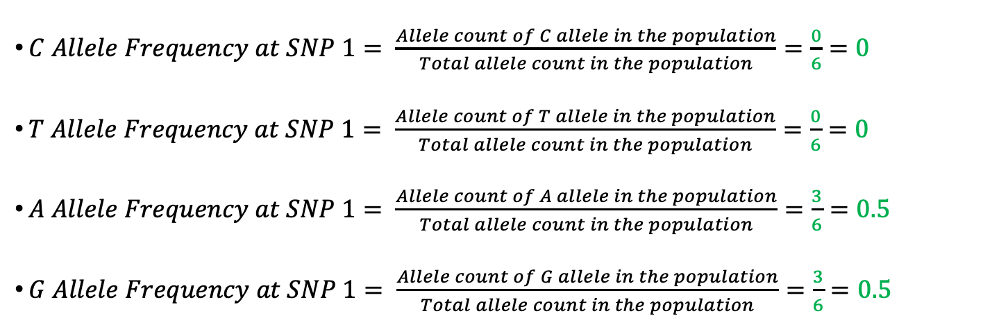
Allele Frequencies
parent 1
parent 2
 | Allele count at DNA SNP site 1
C allele | 0
T allele | 0
A allele | 3
G allele | 3
G / G
A / A
Dataset: 6 total alleles
(3 diploid individuals,
1 DNA site)
offspring
G / A
$C Allele Frequency at SNP 1= \frac{Allele count of C allele in the population}{Total allele count in the population}=\frac{0}{6}=0$
$T Allele Frequency at SNP 1= \frac{Allele count of T allele in the population}{Total allele count in the population}=\frac{0}{6}=0$
$A Allele Frequency at SNP 1= \frac{Allele count of A allele in the population}{Total allele count in the population}=\frac{3}{6}=0.5$
$G Allele Frequency at SNP 1= \frac{Allele count of G allele in the population}{Total allele count in the population}=\frac{3}{6}=0.5$
Ancestry Testing | Activity 2: Sequence Comparison in Ancestry Testing
Notes:
Now the allele frequency fraction for each variant allele can be calculated. Remember that these allele frequencies can also be reported as percentages.

Slide 14
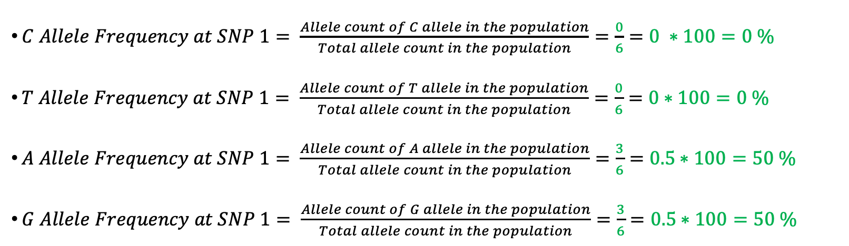
Allele Frequencies
parent 1
parent 2
 | Allele count at DNA SNP site 1
C allele | 0
T allele | 0
A allele | 3
G allele | 3
G / G
A / A
Dataset: 6 total alleles
(3 diploid individuals,
1 DNA site)
offspring
G / A
$C Allele Frequency at SNP 1= \frac{Allele count of C allele in the population}{Total allele count in the population}=\frac{0}{6}=0 ∗100=0 \%$
$T Allele Frequency at SNP 1= \frac{Allele count of T allele in the population}{Total allele count in the population}=\frac{0}{6}=0$ $∗100=0 \%$
$A Allele Frequency at SNP 1= \frac{Allele count of A allele in the population}{Total allele count in the population}=\frac{3}{6}=0.5$ $∗100=50 \%$
$G Allele Frequency at SNP 1= \frac{Allele count of G allele in the population}{Total allele count in the population}=\frac{3}{6}=0.5$ $∗100=50 \%$
Ancestry Testing | Activity 2: Sequence Comparison in Ancestry Testing
Notes:
Remember that these allele frequencies can also be reported as percentages.

Slide 15
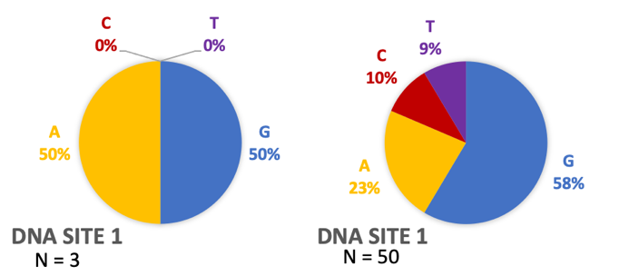
Allele Frequencies
Allele frequencies represent the proportion of each DNA variant observed in “the population”
Dataset changes based on dataset size and diversity
  Individuals
  SNPs
Our example data
N = 3
Another dataset
N = 50
Ancestry Testing | Activity 2: Sequence Comparison in Ancestry Testing
Notes:
Recall that allele frequencies represent the proportion of each DNA variant allele observed in the population. But, what is that population? In our example, we know our dataset is only 3 individuals, and they are biologically related which means they share DNA. Allele frequency data can change based on the population dataset size and the diversity of individuals.
For example, let’s examine the same DNA SNP site 1 in two datasets with a different number of individuals in Figure 6. Our example with 3 individuals gives very different allele frequency numbers than looking at 50 individuals in a larger, more diverse dataset. Graphing this data as a pie chart gives us another representation of the same data, which shows clearly the drastic different in frequencies of each allele with a bigger and more diverse dataset.

Slide 16
DNA Sequencing
Ancestry testing companies perform SNP genotyping at DNA sites with known/high variation
  Called admixture texting
  Some medical tests use similar technology
Whole genome sequencing not performed
Ancestry Testing | Activity 2: Sequence Comparison in Ancestry Testing
Notes:
Ancestry testing companies typically perform this type of SNP genotyping at DNA sites with known and high variation. Interestingly, some medical tests also use similar technology to detect known variants. Whole genome sequencing is not typically performed in ancestry tests.

Slide 17
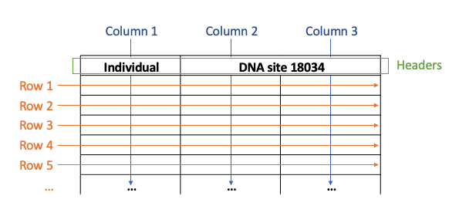
Spreadsheets & Tables
Spreadsheets and tables display information
Cell: each unit of a spreadsheet or table
Column: information from multiple vertical cells
Row: information from multiple horizontal cells
Header: cells with descriptions that provide additional information
Ancestry Testing | Activity 2: Sequence Comparison in Ancestry Testing
Notes:
Spreadsheets and tables are used to display information from different analyses. Each unit of a spreadsheet or table is a cell, and information such as numbers, dates, or words can be entered. When information from multiple cells is arranged vertically, it forms a column. When information from multiple cells is arranged horizontally, it forms a row. Headers are cells with descriptions that provide additional information about what is in a row or in a column.
We already saw an example of a table in Table 1. Each DNA nucleotide is a row with one piece of information that corresponds to it: an allele count number. The allele count number is a column, and has a descriptive header. Go back to review that table to notice the features: it has 2 columns of information, one with a header, and there are 4 rows of data.

Slide 18
Ethics
Ancestry Testing | Activity 2: Sequence Comparison in Ancestry Testing

Slide 19

Ethics
Use the map to circle and label the areas that correspond to each population used by 23Chromosomes
Ancestry Testing | Activity 2: Sequence Comparison in Ancestry Testing

