Slide 1
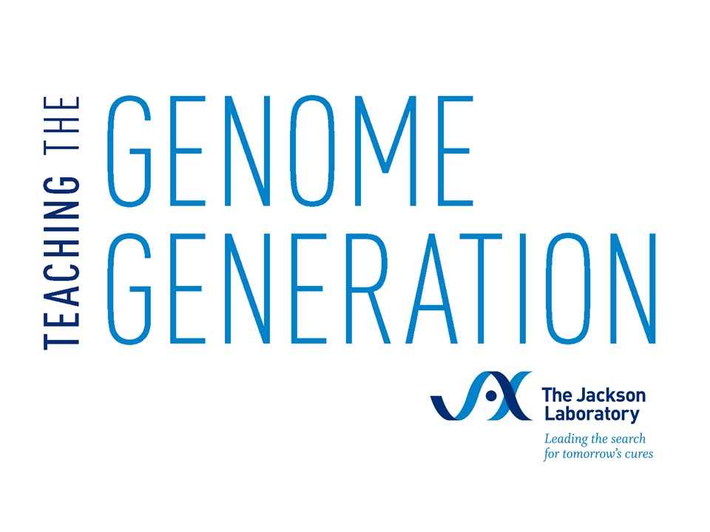
Ancestry Testing
Ancestry Testing & Personal Identity
Ancestry Testing | Ancestry Testing & Personal Identity
Notes:
Updated 5/9/25

Slide 2
Sam’s story
Take the test?
Ancestry Testing | Ancestry Testing & Personal Identity

Slide 3
Sam is at home, alone in their room. They’re thinking about all of the things that happened this week: their birthday wish for an ancestry test, the reactions from their family, and everything they learned about ancestry tests in school, like how they work and what information these tests can reveal. Sam feels so many emotions, from excitement to nervousness. Should they take the test or not? Sam isn’t sure what to do.
Read the scene from Sam’s life. Assign one person as Sam, one person as Tan, and one person as Grandma, and read the scene out loud.
Ancestry Testing | Ancestry Testing & Personal Identity

Slide 4
Sam: What a week! I never thought one little birthday wish would be so complicated!
Gran and Tan had such different reactions to the ancestry test. And now that Dr. V helped me learn how the test works, I realize it could reveal a lot more information that affects both me and my family.
I was so excited about taking an ancestry test. I’ve always wanted to know more about our roots. I think the results could be so cool, it’s the first time in history we have a chance to explore our genomes! But now I know the test isn’t looking at the entire genome, and results depend on each testing company and the references they use. What if I learn something unexpected? Will that change who I am?
Should I be considerate of Gran’s feelings, that she doesn’t think taking the test is a good idea? Should I share Tan’s excitement in getting a chance to explore our family DNA? What if I end up like some of the stories I read about, where people discover unexpected things about their identity or their family history? Will I have to share the news with the family? What will that mean about me and who I am?
There’s so much to think about…
Ancestry Testing | Ancestry Testing & Personal Identity

Slide 5
Prediction
Ancestry Testing | Ancestry Testing & Personal Identity

Slide 6
Sam isn’t sure whether to take an ancestry test. These feelings stem from the reactions from their family, all the things they learned about how the test works, and knowledge that test results also affect their family.
What is the most important factor that would help you decide whether you want to take an ancestry test?
Have you ever changed your mind after learning more information or hearing someone else’s point of view?
Do you think Sam should take an ancestry test?
Ancestry Testing | Ancestry Testing & Personal Identity

Slide 7
Background
Ancestry Testing | Ancestry Testing & Personal Identity

Slide 8
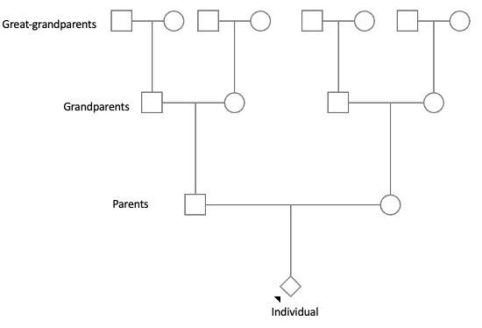
Genetics & Inheritance
Where does our DNA come from?
Each biological ancestor can contribute DNA to an individual
We inherit one half our DNA from each parent
We inherit about one quarter of DNA from each grandparent
We inherit about one eighth of our DNA from each great-grandparent
Ancestry Testing | Ancestry Testing & Personal Identity
Notes:
[Taken from Activity 1: Introduction to Ancestry Testing]
When someone talks about their personal genetics, they are often referring to aspects of their own DNA and genome. The human genome is the complete set of DNA in an individual that encodes the instructions for making each of us who we are. Where does this DNA come from? Typically, each person has two biological parents, four grandparents, eight great-grandparents, etc. as shown in the pedigree in Figure 1. Each of these biological ancestors can contribute DNA to the individual. Individuals inherit half of their DNA from each of their two biological parents, one quarter of their DNA from their four biological grandparents, one eighth of their DNA from their eight great-grandparents, and so on. Therefore, individuals are a mix of DNA from their ancestors; biologically related individuals often share some of the same DNA.
In this pedigree, or family tree, an individual is shown at the bottom. Going up the tree reveals some of their biological ancestors: parents, grandparents, and great-grandparents.

Slide 9
Genetic Testing
Clinical genetic tests
Performed by healthcare professionals
Samples collected in a medical setting
Results are shared with the healthcare provider first
Insurance may pay for some or all of the cost
Direct-to-consumer genetic tests
The individual chooses the test
Samples collected by the individual
Results are shared with the individual
The individual pays for the cost
Thought questions:
Have you ever had a test performed at the doctor’s office? Was it a genetic test?
Have you seen advertisements for direct-to-consumer genetic tests? What information would the test reveal?
Ancestry Testing | Ancestry Testing & Personal Identity
Notes:
[Taken from Activity 1: Introduction to Ancestry Testing]
Genetic testing is a category of laboratory tests that examines an individual’s genes or other biological factors that influence genetic functions and traits. A small sample of cells, typically from blood or saliva, is taken from an individual and DNA, RNA, and/or protein molecules are examined. The goal of genetic testing is to better understand a person’s DNA features, RNA patterns, or protein levels and how they influence a person’s health, traits, or genetic heritage. Many types of genetic tests have been developed for a variety of purposes, including karyotype tests that count the number of chromosomes per cell to look for genetic conditions such as trisomy 21 (Down Syndrome); tumor tests that examine tumor cells to determine drivers of and treatments for cancer; and paternity tests that reveal an individual’s biological relatives.
Most genetic tests are conducted through healthcare professionals like doctors; these types of tests are called clinical genetic tests. Doctors often determine a test is needed due to a specific medical reason, such as a family history of a genetic disorder or symptoms that suggest a genetic condition. Samples like blood or saliva are collected in a medical setting and analyzed in a clinical laboratory. Once the test is complete, the results are sent to the healthcare professional who then shares them with the individual. With clinical genetic tests, health insurance may cover some or all of the cost of the test.
In contrast, direct-to-consumer genetic tests are tests that can be purchased directly by people without a doctor’s order. They are often advertised as a way to learn about your ancestry, genetic traits, or health risks directly from your DNA. Individuals choose what test they want performed, and collect and send their own samples to the testing company. The testing company analyzes the samples, and once the test is complete the results are sent directly to the individual. With direct-to-consumer genetic tests, the individual pays for all of the cost of the test.

Slide 10
Ancestry Testing
DNA ancestry tests are direct-to-consumer genetic tests
Examine specific locations in an individual’s DNA
Find similarities between groups of people
Predict their ancestral origins
Ancestry Testing | Ancestry Testing & Personal Identity
Notes:
[Taken from Activity 1: Introduction to Ancestry Testing]
DNA ancestry tests, or genealogical DNA tests, are a type of direct-to-consumer genetic test that examines specific locations in an individual’s DNA to find similarities between groups of people and predict their ancestral origins. Since DNA is passed from biological parents to their offspring, it is possible to trace genetic ancestors by examining a person’s DNA. This process relies on comparing an individual’s DNA to reference databases containing genetic information from populations of people worldwide. Each company uses a different approach to for the ancestry test, and may offer additional features such as health reports and family matching.
Ancestry testing has gained popularity in recent years due to its ability to uncover previously unknown family connections, shed light on migration patterns, and help individuals better understand their roots and cultural identities.

Slide 11
Genetic Information & Privacy
Genetic test results from one person may reveal information about other biological relatives
The US Genetic Information Nondiscrimination Act (GINA) protects genetic information
Thought question:
GINA protects genetic information specifically regarding health insurance and employment. In what other contexts might genetic information privacy be relevant?
Ancestry Testing | Ancestry Testing & Personal Identity
Notes:
[Taken from Activity 1: Introduction to Ancestry Testing]
Genetic tests offer valuable insights into in individual’s genetic makeup, and can advance understanding of a person’s ancestry, disease predisposition, and personalized medical treatments. However, they also raise profound concerns about privacy and ethical implications of sharing one’s most intimate biological data. Since DNA is inherited, one person’s genetic test results may reveal information about other biological relatives. The sharing of genetic data can expose individuals and families to risks such as genetic discrimination, breaches of confidentiality, and unauthorized access to sensitive information.
In the United States, the Genetic Information Nondiscrimination Act (GINA) provides protection for genetic information. This federal law protects the confidentiality of genetic information, and orders that genetic information be part of a person’s confidential medical record to be stored and shared under strict privacy standards. GINA also specifically protects against discrimination based on genetic information for health insurance and employment. GINA prohibits health insurance companies from using genetic information to alter a person’s health insurance benefits. This law also prohibits employers from making decisions about hiring, firing, or promotions based on genetic information.

Slide 12
Debate and argumentation skills
Debating is a way to explore different sides of an issue: make a claim (your main point), support it with evidence (facts, examples, or data), and use reasoning to explain how that evidence supports your claim.
Strong arguments are clear, logical, and based on trustworthy information, not just opinions or emotions.
Good debaters also listen carefully to opposing views and respond respectfully. Counterarguments and rebuttals between each side should be calm, respectful, and focused on ideas not personal attacks.
Ancestry Testing | Ancestry Testing & Personal Identity
Notes:
When making important decisions, especially ones that involve personal health, family, or privacy, it’s helpful to think through both the short-term and long-term consequences. What impact will this decision have immediately? What effects might be more long lasting? Good decision-making involves gathering accurate information, considering different perspectives, and reflecting on your own values and goals. For example, deciding whether to take an ancestry test might require weighing curiosity about your family roots against concerns about privacy or unexpected results.
A key part of responsible decision-making is informed consent. This means understanding what you're agreeing to, including the possible outcomes, risks, and how your information may be used or shared. It’s also important to recognize when emotions or outside influences (like ads or peer pressure) are shaping your thinking, and to take a step back to focus on what matters most to you personally. Being aware of this kind of bias, both in ourselves and in the sources we use, helps us make more thoughtful and balanced decisions.

Slide 13
Decision making skills
Good decision making involves gathering accurate information, considering different perspectives, and reflecting on your own values.
Informed consent means understanding what you’re agreeing to, including the possible outcomes, risks, and how your information may be used or shared.
Bias in ourselves and in the sources we use for our arguments can shape our thinking by focusing on emotions and outside influences rather than truth and facts.
Ancestry Testing | Ancestry Testing & Personal Identity
Notes:
When making important decisions, especially ones that involve personal health, family, or privacy, it’s helpful to think through both the short-term and long-term consequences. What impact will this decision have immediately? What effects might be more long lasting? Good decision-making involves gathering accurate information, considering different perspectives, and reflecting on your own values and goals. For example, deciding whether to take an ancestry test might require weighing curiosity about your family roots against concerns about privacy or unexpected results.
A key part of responsible decision-making is informed consent. This means understanding what you're agreeing to, including the possible outcomes, risks, and how your information may be used or shared. It’s also important to recognize when emotions or outside influences (like ads or peer pressure) are shaping your thinking, and to take a step back to focus on what matters most to you personally. Being aware of this kind of bias, both in ourselves and in the sources we use, helps us make more thoughtful and balanced decisions.

Slide 14
Activity
Ancestry Testing | Ancestry Testing & Personal Identity

Slide 15
Debate
Opening statements (1 minute per side)
Main arguments (3 minutes per side)
Questions and rebuttals (5 minutes per side)
Questions and rebuttals (5 minutes per side)
Closing statements (1 minute per side)
Respectful discussion means:
Listen carefully to each speaker
Respond politely, using evidence rather than opinions alone
Avoid interrupting or personal attacks
Ancestry Testing | Ancestry Testing & Personal Identity
Notes:
Now it’s time to debate! This is an important time where both sides will present their arguments, listen carefully to each other, and have a chance to ask questions and discuss.

Slide 16
Debate
Debate section |  | Team A: in favor of Sam taking an ancestry test | Team B: against Sam taking an ancestry test
Opening statement
Point #1 | Claim
 | Evidence
 | Reasoning
Point #2 | Claim
 | Evidence
 | Reasoning
Point #3 | Claim
 | Evidence
 | Reasoning
Closing statement
Ancestry Testing | Ancestry Testing & Personal Identity
Notes:
You

